Slide 1

The Unimart E-commerce
unimart.tech
PROJECT PRJ301
Student name: Le Trong Linh
Professor: Ms. Do Thi Loan

Slide 2
Structure of project
01

Slide 3
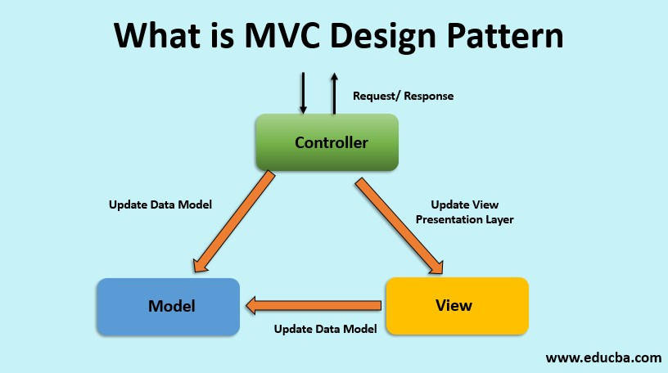
MVC Design Pattern

Slide 4
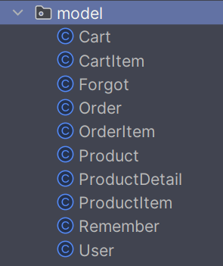
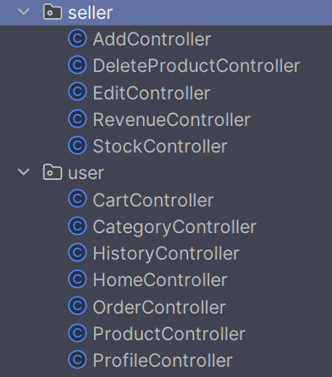
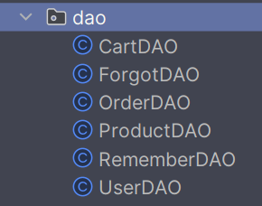
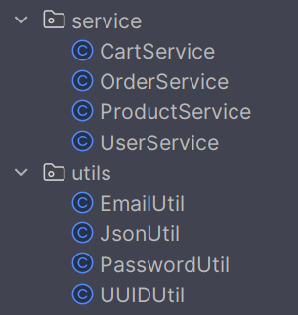
MVC Design Pattern

Slide 5
URL Patterns (RABC)
For admin role
admin/account
admin/delete/*
For all user
user/cart
user/categries
user/history
order/*
For seller role
seller/add
seller/delete/*
seller/edit/*
seller/revenue
seller/stock
For anonymous
user/cart
user/categries
user/history
order/*

Slide 6
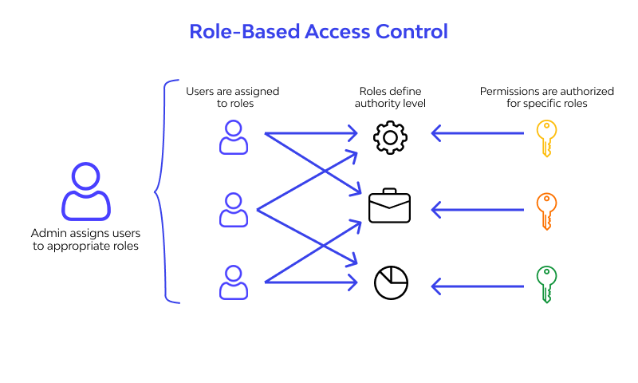

Slide 7
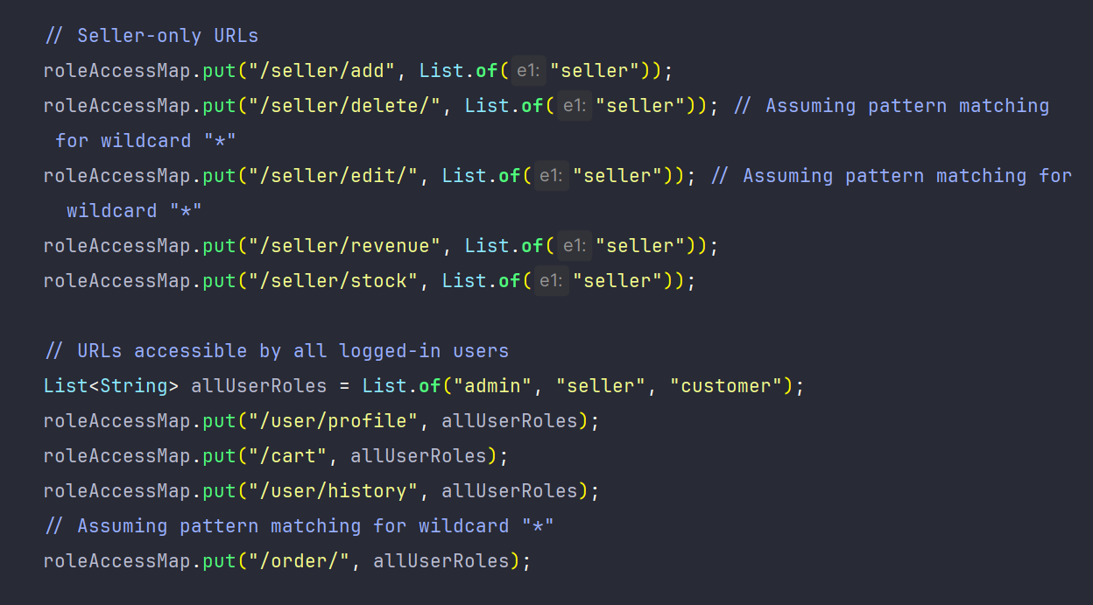

Slide 8
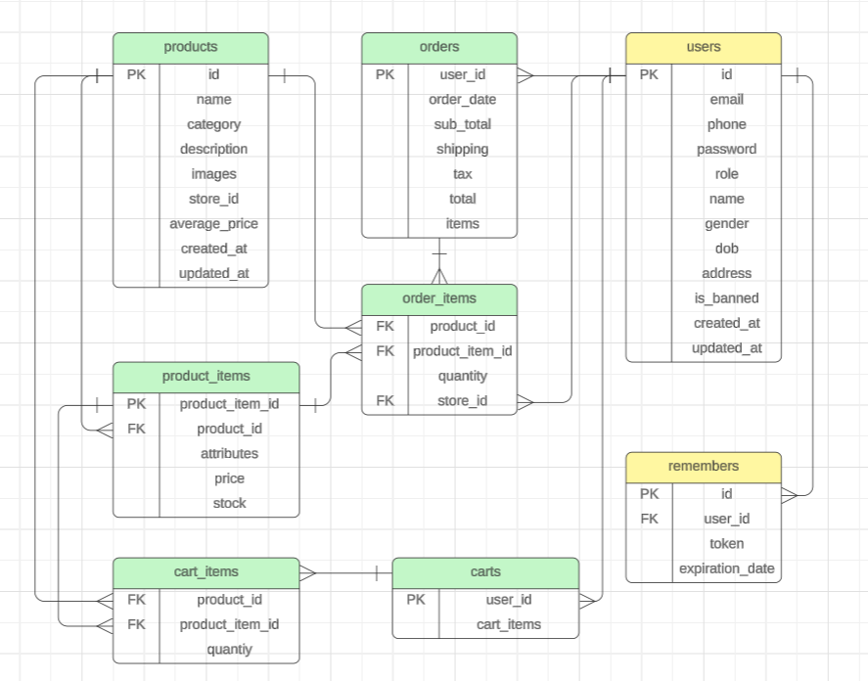
Database Design

Slide 9
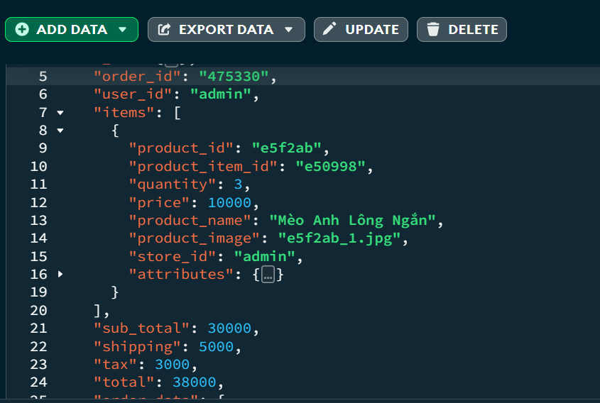
MongoDB Schema

Slide 10
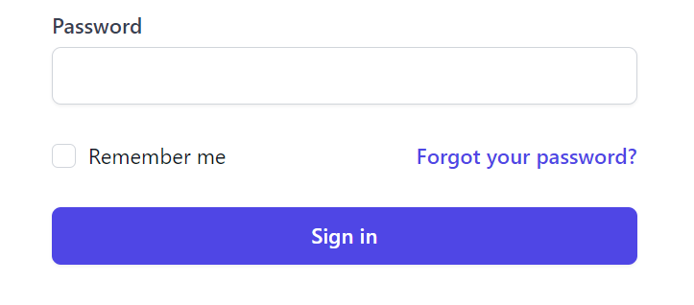
Remember me feature

Slide 11
Remember me mechanism
1. When generating a RM token, set an expiration for the token. Store this time along with the token in the RM table in DB.
2. When a user logs in using the RM token, check the expiration date of the token stored in the DB. If the token has expired, prompt the user to log in again. This ensures that expired tokens are not accepted for authentication.
3. If a user unchecks the "Remember Me" option during login, you can delete all existing tokens associated with their account from the database. This step ensures that any existing remember-me tokens are invalidated, as the user has explicitly indicated that they don't want to be remembered.

Slide 12
Remember me mechanism
3. If a user unchecks the “RM" option during login, we will delete all existing tokens associated with their account from the DB. This step ensures that any existing RM tokens are invalidated, as the user has explicitly indicated that they don't want to be remembered.
4. We also invalidate all tokens when user log out to secure user’s account.

Slide 13
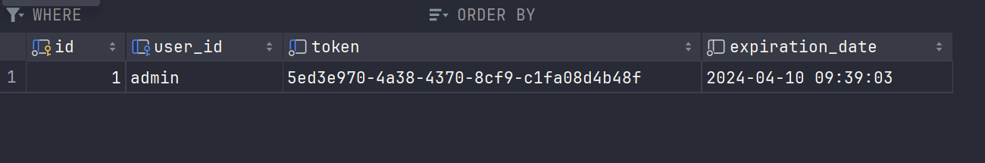
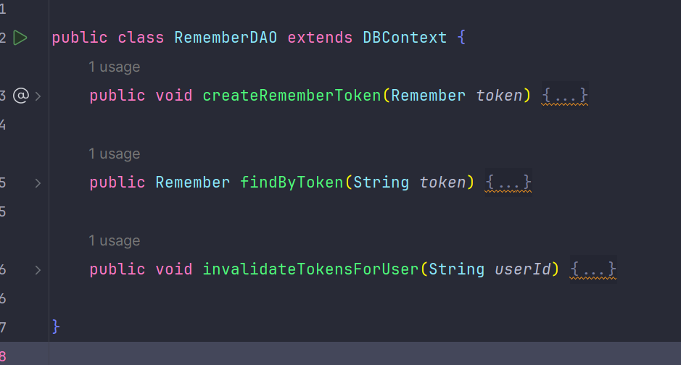
Remember me feature

Slide 14
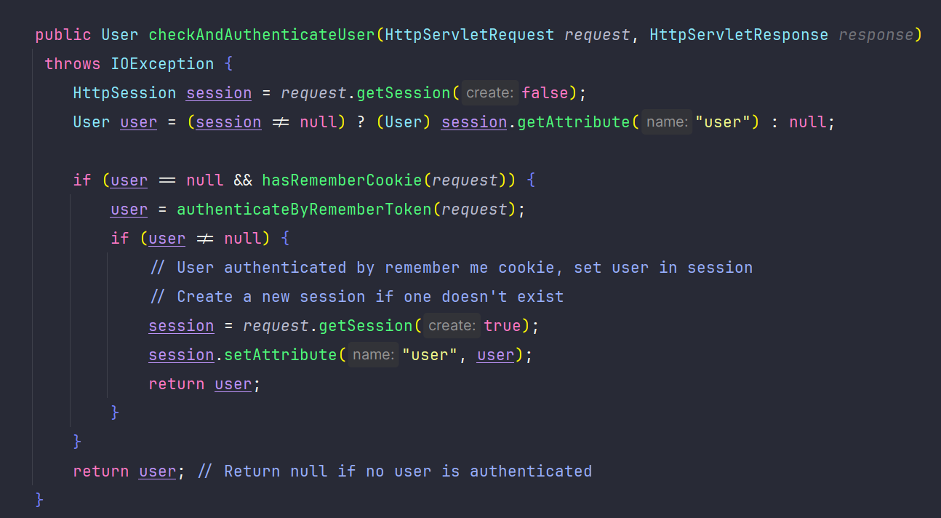
Remember me feature

Slide 15
Transaction:

Slide 16

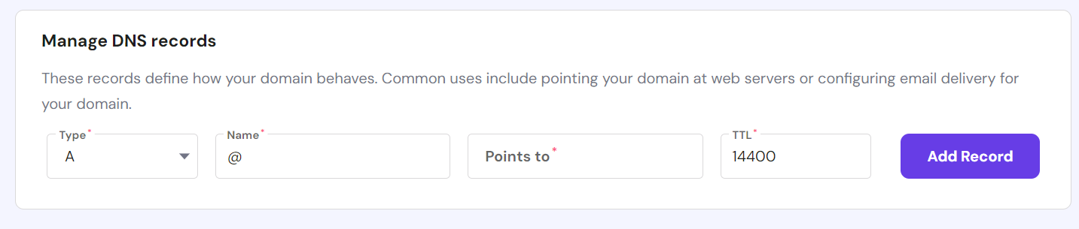
AWS EC2 + Hostinger Domain

Slide 17
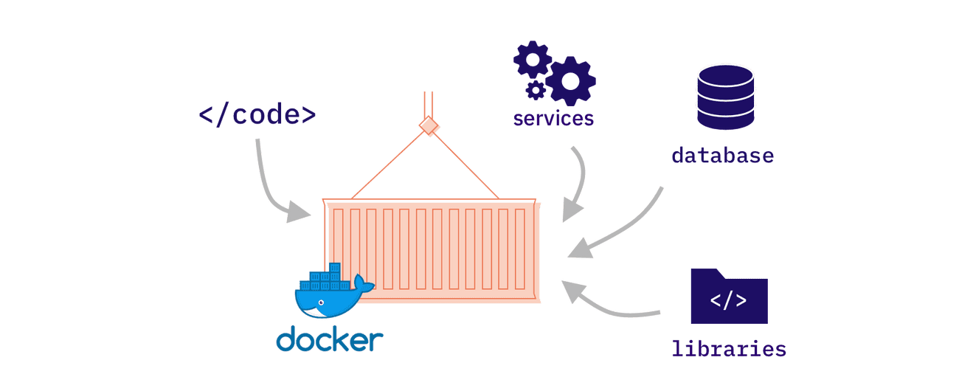
Deploy using Docker

Slide 18
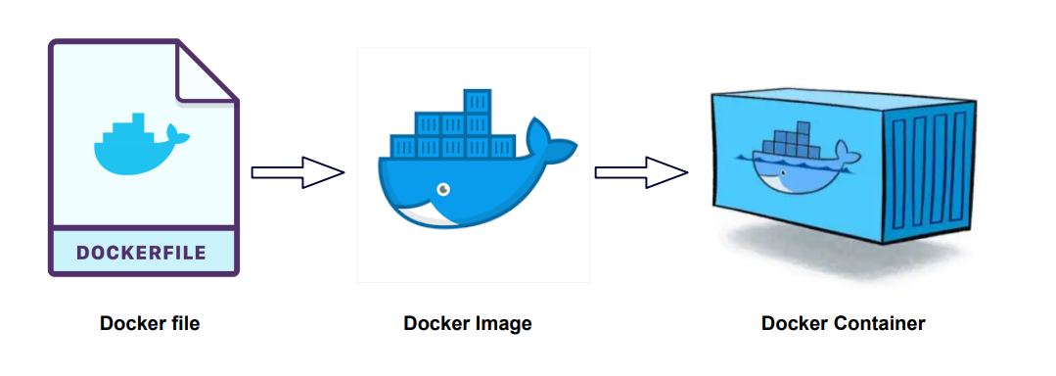
Deploy using Docker

Slide 19
Using Tailwind CSS
Rapidly build modern websites without ever leaving your HTML.
A utility-first CSS framework packed with classes like flex, pt-4, text-center and rotate-90 that can be composed to build any design, directly in your markup.

